Slide 1


Welcome
DotCom Services (India) Pvt. Ltd.

Slide 2





COMPANY BACKGROUND
Founded In : November 1996
Business : State-of-art IT & Web Solutions
Headquarters : Mumbai, India
Branches : Bangalore, Guwahati, USA and Singapore
Partnerships :
Leadership : Driven by a leadership team of high profile
management and IT professionals.
Building Blocks :
Visionary Leadership.
Strong Skill Pool & Resource Management.
Commitment to Quality and Excellence.
Customer-Centricity.

Slide 3
TRACK RECORD
Strong Pedigree
18+ Successful years in IT Business
26000+ satisfied customers in Indian and International Market
Qualified and Experienced Team
Robust Delivery Capability
40 + professional team of experts, engineers, software architects, analyst and consultants to manage and execute project in strategically and timely manner.
Successfully developed and provided web solution in Indian and International Market
Achievements
Maximum Customer Satisfaction
80% of the business conducted through existing customers

Slide 4
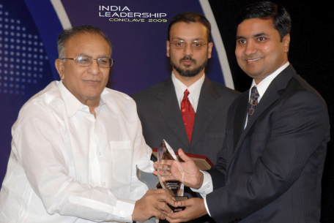
STRATEGIC POSITIONING
The company was awarded an
'INDIA'S MOST PROMISING IT & WEB SOLUTIONS COMPANY’
for the year 2009 & 2011 for its commitment to Quality and Excellence.

Slide 5

TOTAL WEB SOLUTIONS
Domain Registration
Corporate Web & Email Hosting
Dedicated & VPS Server
Web Designing & Development
E-commerce & Portal Development
Software Development
Website Maintenances
Logo Designing & Branding Solutions
Brochure & Marketing Collaterals Designing
SSL Certificate
SEO / Emailer Marketing / SEM
Offshore Development

Slide 6

IT Outsourcing Services
We offer "Complete IT Outsourcing ", wherein we manage every aspect of technology be it Processes & Policies, Infrastructure, People, Procurement, Vendor Management, Systems and Solutions, Audit and much more...
Why Outsourcing
External Specialists & Trained Staff
Faster ramp-up
No retention headaches
FTE head-count limits
Minimise financial overheads
Hire Now
.Net Developer
Java Developer
PHP Developer
C++ Developer
AJAX Developer
Flash, Action Script Designer
CSS, XHTML Designer
Web 2.0 Designers
HTML5 & CSS3 Designer
Web & Graphic Designer
Data Entry professionals
QA Tester's

Slide 7








DOMAIN EXPERTISE
MNC & FMCG

Slide 8







DOMAIN EXPERTISE
Banking & Financial Services

Slide 9
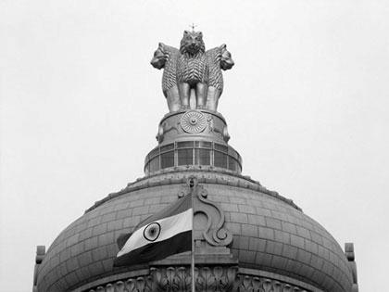











DOMAIN EXPERTISE
Government
Mangroov Cell
Election Commission

Slide 10











DOMAIN EXPERTISE
Education

Slide 11








DOMAIN EXPERTISE
E-commerce

Slide 12







DOMAIN EXPERTISE
Organization / Association

Slide 13










DOMAIN EXPERTISE
Manufacturing

Slide 14

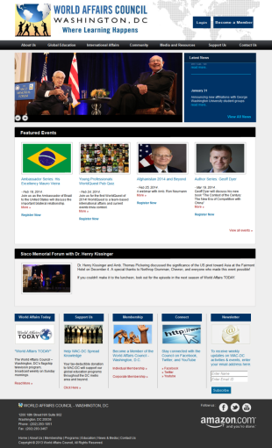
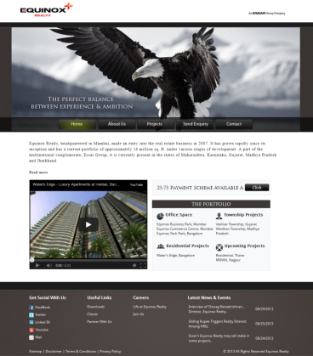
WEB DESIGNING AND DEVELOPMENT PORTFOLIO
Worldaffairsdc.org Equinox Realty

Slide 15
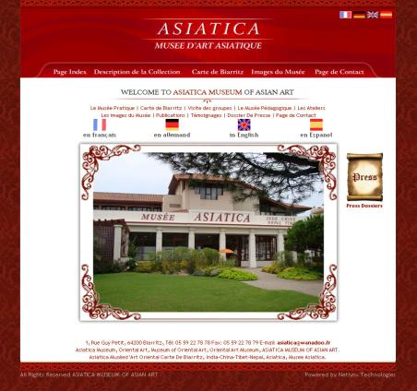
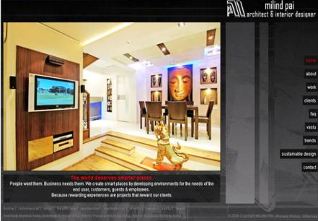
WEB DESIGNING AND DEVELOPMENT PORTFOLIO
Musee Asiatica Milind Pai

Slide 16

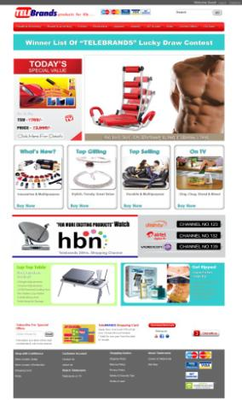
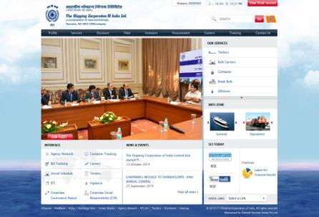
WEB DESIGNING AND DEVELOPMENT PORTFOLIO
Shipping Corporation Tele Brands

Slide 17
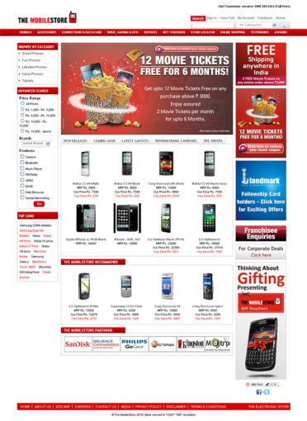
WEB DESIGNING AND DEVELOPMENT PORTFOLIO
The Mobile Store

Slide 18

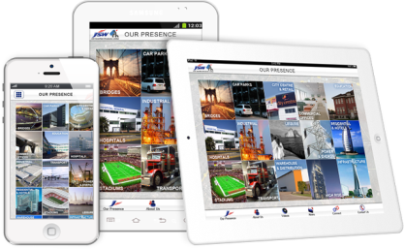


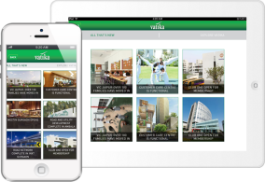
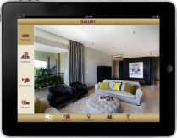
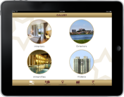
MOBILE APPS - PORTFOLIO
CarTrade App
JSSL (Jindal) Real Estate App
Hoope; Veenus
Vatika Group – Real Estate App
Hiranandani APP for Sales
Planet Radio City

Slide 19


BROCHURE DESIGNING PORTFOLIO

Slide 20
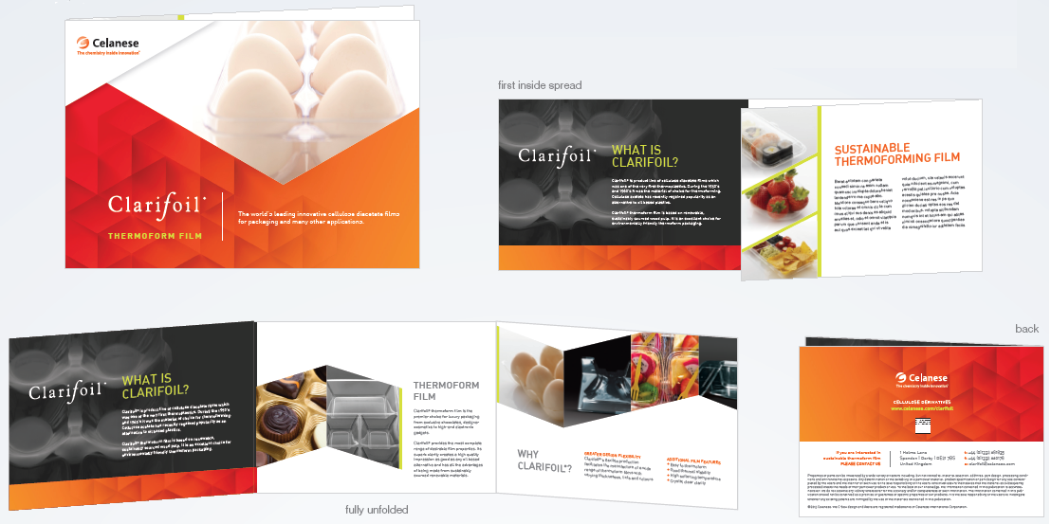
BROCHURE DESIGNING PORTFOLIO

Slide 21



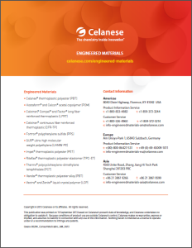
BROCHURE DESIGNING PORTFOLIO

Slide 22
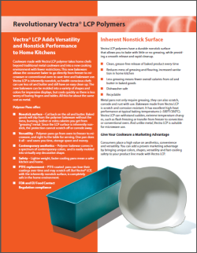

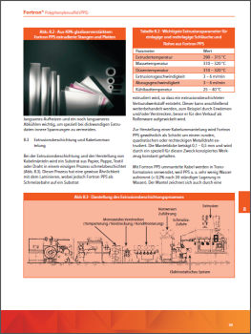
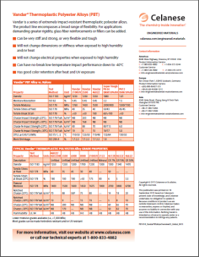
BROCHURE DESIGNING PORTFOLIO
Technical Sheets

Slide 23











PARTIAL CLIENTELE

Slide 24














PARTIAL CLIENTELE

Slide 25


















PARTIAL CLIENTELE

Slide 26











PARTIAL CLIENTELE

Slide 27
ACHIEVEMENTS
HERE’S WHAT SOME OF OUR CUSTOMERS HAVE TO SAY ABOUT US:
“I couldn't be happier with my choice of using Dotcom for my new website. The team was easy to work with and helped me make a very good website in a short amount of time. ”
Mr. Syed Mazhar Ali
Asst. Chief Manager - IT
CMI-FPE
“We chose dotcom service because of their expertise in web-based technologies, their commitment to deadlines and professional handling of the projects . Thanks once again for all your efforts.”
Mr. Hemant Bhure - Manager
Anchor Electricals Pvt. Ltd.

Slide 28
ACHIEVEMENTS
“Worldindia.com have been efficient in their commitment to ensure quality services in terms of timely updating and modification of the website as and when requires by SASMIRA. Since 1998. Thanks.”
Dr. Manisha Mathur – Asst. Director
SASMIRA
“We have been dealing with worldindia.com for the past 8 years. We have developed and hosted our website and Email Database on their servers and have been availing their expertise for maintaining the above. During our relationship worldindia.com has provided us prompt and excellent service and we will definitely recommend you to anyone & are quite proud to be affiliated with worldindia.com.”
Mr. W.L.Pinto - Sr. Manager
Empire Industries Ltd.

Slide 29

CONTACT US
INDIA
Mumbai
101/102/103 Tirupati Udyog, I. B. Patel Rd.,
Goregaon (E), Mumbai-400063.
Email : sales@worldindia.com
Tel : 91-22-40811111
Fax : 91-22-40811100
Guwahati
337, Simon House, Opp. Nepali Mandir,
Paltan Bazar, Guwahati-8, Assam
Tel: 0361-2607819
Bangalore
#516, 2nd Main,
'A' Block, 2nd Stage,
Rajajinagar, Bangalore – 560055
Tel: +91 9980542911
INTERNATIONAL
USA
# 200 Middle Essex Tpk, # 204,
lselin NJ 08830
Email: usa@worldindia.com
Singapore
686S, #15-264,Choa Chu Kang
Crescent, Singapore - 684686
Email: sg@worldindia.com. Tel: +65 91861490

Slide 30
Thank You
Contact us
+ 91-22-40811111
Email us
sales@worldindia.com
Visit us
www.worldindia.com
Private and confidential. Not to be used by anyone other than addressee and addresser.

